Slide 1


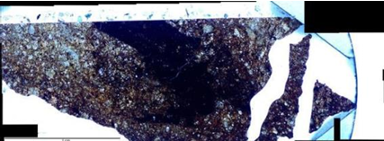
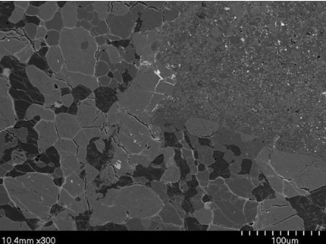
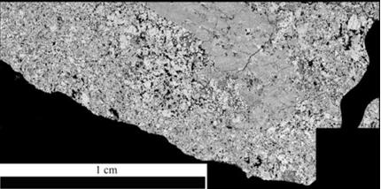
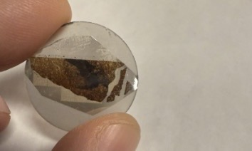
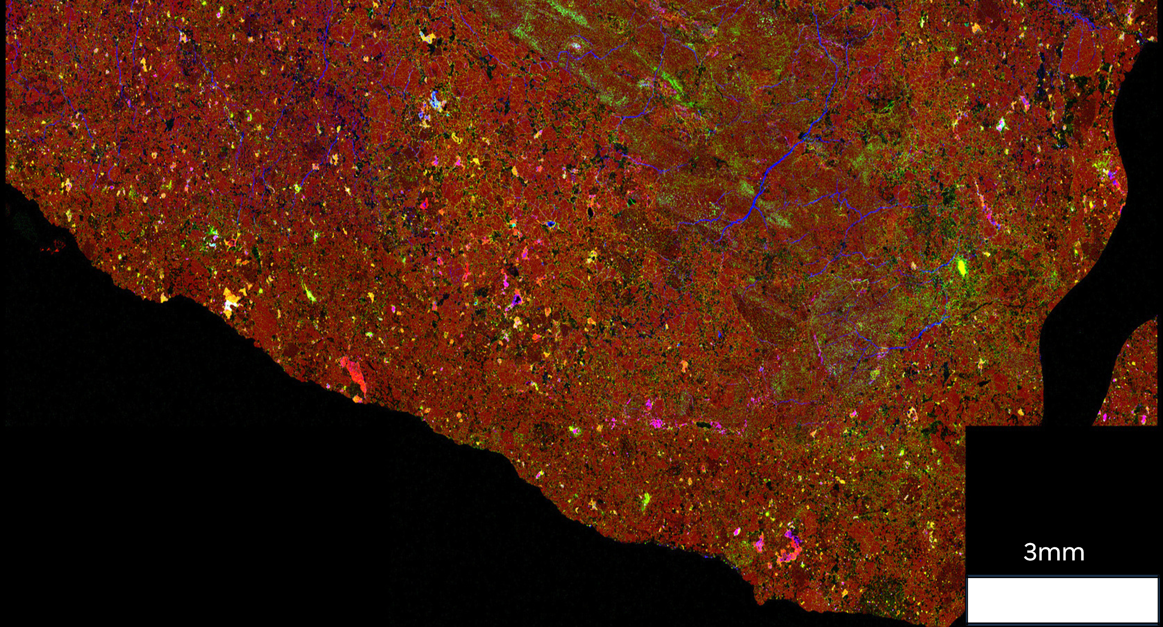
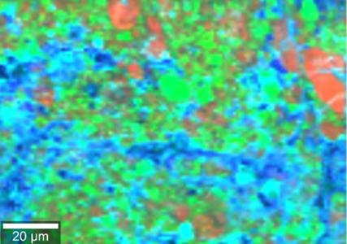
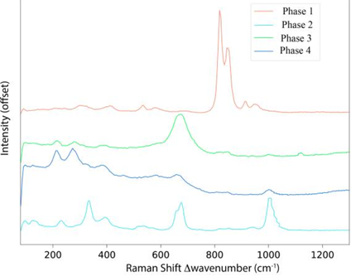

MINERALOGY OF THE SAHARA 97037 METEORITE: INSIGHTS FROM PETROGRAPHY, EPMA, AND RAMAN SPECTROSCOPY
  Faruq Anjorin¹, Steven J. Jaret^{¹,²,³}, R. Davies⁴, M. Gemma²
  ¹Dept. of Physical Sciences, Kingsborough Community College; ²Dept. Earth & Planetary Sci., AMNH; ³CUNY Graduate Center; ⁴Queensborough Community College
  faruq.anjorin52@students.kbcc.cuny.edu
INTRODUCTION & SAMPLE
FIGURES
RESULTS & INTERPRETATION
Type & significance: Sahara 97037 is an LL7 ordinary chondrite - one of the most thermally processed LL chondrites; type 7 indicates near-complete erasure of original chondrule textures and intense parent-body heating.
Why study it: Type-7 meteorites give constraints on internal thermal structure and parent-body evolution that are otherwise poorly sampled.
Shock-melt vein (~2.9 mm): Dark, sharp-bounded, nearly opaque in transmitted light.
Mineral compositions: Vein contains two olivine compositions (Fo₉₅ and Fo₆₅) and pyroxene En₉₇ (fine-grained). Grains adjacent to the host lithology are larger and exhibit a granoblastic texture.
Bulk mapping trends: Vein enriched in Fe & Cr, depleted in Si relative to host; Mg map shows three compositional regions.
Figure 2: Plane-polarized light image of Sahara 97037.
Four phases identified within the vein:
Figure 1: Sahara 97037 Thin section showing a dark, continuous melt/shock vein crossing the host lithology.
Olivine (dominant bands ~845 & 820 Δcm⁻¹; small at 912 Δcm⁻¹).
Pyroxene (dominant ~1006 Δcm⁻¹, doublet near 687 Δcm⁻¹; likely clinoenstatite).
Chromite (broad ~678 Δcm⁻¹ plus smaller peaks; consistent with Cr enrichment).
Fine-grained pyroxene (weaker ~1000 Δcm⁻¹ peak).
Figure 3: BSE image of the contact between the vein and the host meteorite.
Figure 4: (Mg) map shown in black & white, where bright areas indicate high & dark areas indicate low Mg.
KEY OBSERVATIONS
Prominent ~2.9 mm dark vein cutting olivine-dominated host.
Host shows granoblastic textures adjacent to vein, consistent with contact metamorphism. Gray et al., 2025. MAPS 60, 51-63
Interpretation
Shock-melt vein: Fine-grained olivine (Fo₉₅–Fo₆₅) and pyroxene (En₉₇) with Fe–Cr enrichment indicate rapid crystallization from shock-generated melt and localized thermal overprinting of the host.
Geologic Significance
LL7 record: Provides rare evidence of extreme shock-induced melting and short-lived high-temperature processes on an LL chondrite parent body.
Fe (red)
Ni (green)
S (blue)
METHODOLOGY
Figure 5: High-resolution EPMA map showing the distribution of iron (Fe), nickel (Ni), and sulfur (S).
Optical petrography (Olympus BH2) and BSE imaging (Hitachi S4700).
EPMA / WDS mapping at the American Museum of Natural History (Cameca SX5-Tactis). Mapping parameters: beam 40 nA, dwell 15 ms, step 6 µm; full section = mosaic of 15 EPMA maps.
Raman spectroscopy (WiTec Alpha300R, 532 nm, ~20 mW); mapping resolution 751nm.
REFERENCES
Figure 6: Raman image (Left) and spectra (Right) of mineral phases within the large vein. Phase 1 is olivine, Phase 2 is pyroxene, Phase 3 is chromite and Phase 4 is pyroxene which is likely clinoenstatite.
To access the complete Reference list, Scan this QR code
Acknowledgements
Thanks to Denton Ebel and the Museum of Natural History for curation; Celine Martin for EPMA & Raman access; supported by the CUNY Research Scholars Program (CRSP)

